Slide 1






Achieving a Common Purpose in the Real World of Public Services
EQUITY
RELEVANCY
CAPACITY
Success
Dennis Culhane and John Fantuzzo, University of Pennsylvania, 2011

Slide 2
Problems
Top-down hierarchies
Silo-ed information
Lack of partnerships

Slide 3


Kids Integrated Data System Model
Key Partners:
City of Philadelphia
School District of Philadelphia
University of Pennsylvania
William Penn Foundation
Notes:
3

Slide 4
Integrating Data across Government Services
Education
Justice
Housing
THE WHOLE
PERSON
Child Welfare
Health Care
Disabilities
Mental Health
Public Safety

Slide 5
Integrated Data for KIDS Research
Department of Human Services
  Child Maltreatment
  Out-of-home Placement
Office of Supportive Housing
  Homeless shelter stays
Public Health
  Birth Records
  TANF receipt
  Lead exposure
Behavioral Health Services
  Diagnosis, Therapy,
  Prescription medications
School District
    Achievement
    Attendance
    Classroom Behavior
Notes:
5
Risk factors included in study are continually monitored by city agencies & school district.
They were provided by 4 separate agencies & SDP – demonstrates capacity of KIDS.

Slide 6
Data &
Services
Data &
Services
Education
Health,
Mental Health, and Nutrition
Family Support
KIDS
Special Needs,
Data &
Services
Data &
Services
Source: National Center for Children in Poverty

Slide 7

OPERATIONS
Executive Leadership
[Governing Board]
KIDS
Stakeholders &
Practitioners
Researchers
[Research Advisory Board]
[Project Advisory Teams]
Research Director
Data Base Administrators
Administrative Assistant
John Fantuzzo & Dennis Culhane, University of Pennsylvania, ISP, 6/8/11

Slide 8
Why is it of value to both educators & health and social service providers?

Slide 9


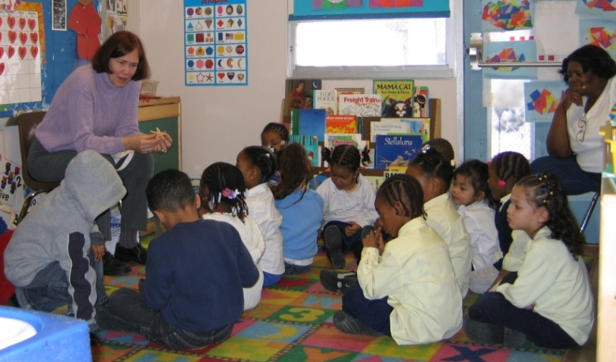
Actionable Intelligence
Cross-Agency
Collaboration
Improve
Quality

Slide 10
Making Essential Connections within Education and across Education & Health and Human Services
Community
Family
School
Classroom
Child

Slide 11
What can you do with the information that this type of system can provide?

Slide 12

Critical Transitions & Transactions
Out of School Youth
Homelessness &
School Mobility
Early School Success

Slide 13
CLOSING THE GAP:
Useful Information & Interventions
Identify & lessen risks to Poor Educational Outcomes
#1
#2
Improve the QUALITY
of Education & Human Services for
Children & Families
EPIC
Evidence-base Program for Integrated Curricula

Slide 14
Key Findings/Actions
Identified risk and protective factors associated with success
Obtained support to scale up across larger share of district pre-K programs
Working with multi-agency stakeholders to impact mutable factors (homelessness, lead exposure, maltreatment, maternal education)

Slide 15




Out of School Youth
Out of School Youth

Slide 16
Key Findings/Actions
Identified “early warning” indicators for high school drop out (early middle school math achievement problems, truancy)
Developed earlier intervention targets
Created typology of drop-outs
Developed programs targeting subpopulations of drop-outs (older learners, youth with foster care experience)

Slide 17
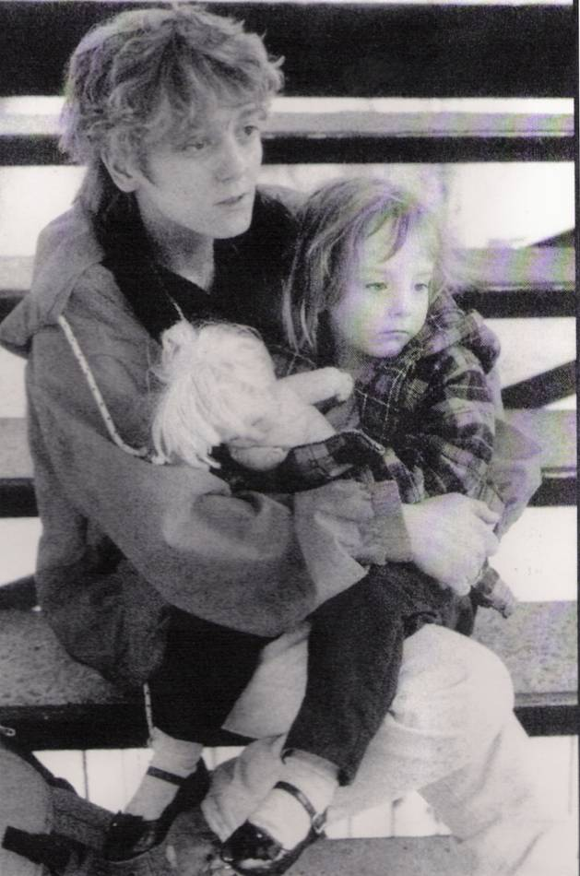



Unique effect of Homelessness
on Academic and Behavioral Adjustment

Slide 18
Findings/Action
School mobility and homelessness account for significant proportions of achievement gap
School-level effects are in some cases stronger than individual-level effects
Identified problem with McKinney compliance at shelters
Developing alternative stabilization models for homeless families

Slide 19
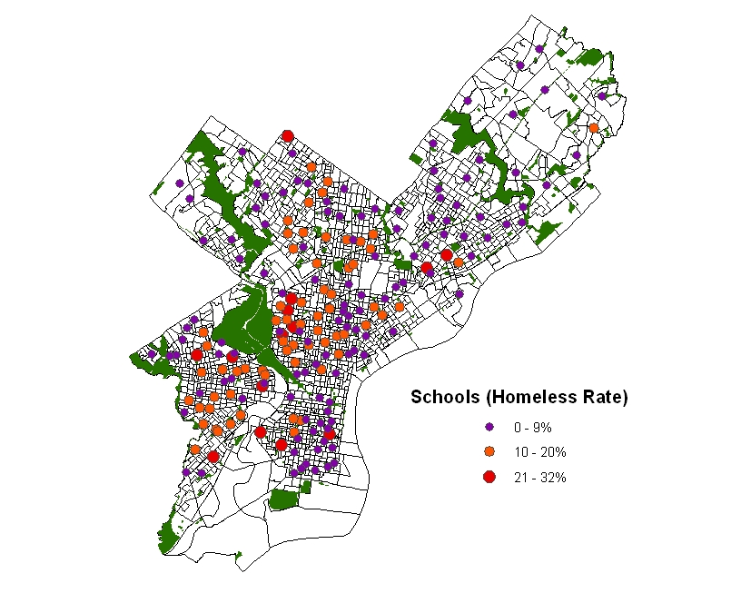
Homelessness Rates by School
Average = 9%
School Mobility

Slide 20
How do you develop and sustain such a system?

Slide 21

Intelligence
Executive
Leadership
Improve
IDS
Benefit Cost
Researchers
Data Analysts
SHARE
Practitioners
Stakeholders
USE Ethics
INTEGRATE Science
GET Legal Issues
Notes:
This represents the typical way scientist-practitioners proceed . . . We gather information using various assessment procedures, so we start with our measures, our independent and dependent variables . . . Then based on the information we obtain from these measures, we form and conduct interventions, and then we test the interventions’ impact . . . This model recognizes the incredible level of partnership necessary to serve as the substantial base for all of the above activities . . . However, establishing partnerships is not sufficient . . we need to build resource capacity through partnership in systems for all of the above . . . This is the key issue upon which quality work rests and is the element most often missing from our efforts. . .

Slide 22
Current ISP Network
New York
Los Angeles
Chicago
Philadelphia
Pittsburgh
Cleveland
Michigan
Florida
South Carolina
Washington State

Slide 23

Questions
KIDS
Questions
John Fantuzzo, University of Pennsylvania, 4/13/11

